Slide 1

December 2020
Progress Report

Slide 2
Programme
Yorkshire & Humber Care Record
SRO
John Byrne
Lead
Lee Rickles
RAG status
Amber
Reporting Period
December 2020
Key Messages
Yorkshire & Humber shared record plan has been submitted to NHS X and NHS E&I; £4.8mil has been awarded to YHCR to roll out Shared Care Records (50% of the Core Information Standard) to Trusts and General Practice across the region by September 2021 251 data processing to allow the data from SoS to be de-id for PHM has been approved subject to caveats which are near completion Humber FT providing data to the system of systems
Key activities & milestones achieved in this reporting period | Key activities & milestones planned for next reporting period
Population Health 251 data processing has been approved subject to a number of caveats, one of those being public engagement sessions regarding an enhanced opt out approach. These commended Friday 08 January 2021; first session will provide a steer for the rest | Population Health Transition to long term service in progress. Work on the 251 caveats to continue Continued public engagement sessions regarding an enhanced opt out approach.
Integrated Care Record A majority of the organisations in on-boarding move to the test stage. Testing has started for TPP non-GP API data transfer. User interface developed has been presented to clinical safety officers for feedback | Integrated Care Record HCV phase 1 of the 111First development is progressing
Enduring organisation YHCR admin and Product Manager in post, Service Manager role is out for recruitment. | Enduring organisation HCV ICS executive board to approve the YHCR value case. The central programme team is to be continued for all of 20/21.
Partners YHCR to support the COVID 19 phase 3 ICS submissions for shared care records and population health. | Partners COVID 19 phase 3 shared care record ICS submissions made to NHSX, and £4.8mil has been awarded.
Items of escalation: £4.8mil funding needs to be drawn before end March 2021. Value of draw down to be considered by Delivery Board.

Slide 3

Integrated Care Record Project
Highlight Report | 11/01/2021

Slide 4
Highlight Report - Yorkshire and Humber Integrated Care Record Programme Report Date: 11 January 2021
Summary Dashboard
Current Phase:
Implementation
Overall Status:
Based on original baseline plan
Pipeline
Top Stories
NEW Product Owner, Ian Clucas joins the team with extensive knowledge and experience
HUTH scheduled to switch to live data provision on 20 Jan
Blackpear to provide EoL data will switch on 14 Jan
Rotherham Ambulatory transfer of care live service scheduled to switch on 20 Jan
Humber and NLAG GP Connect consumer portal accreditation expected in January 2021
Engagement Opportunity
EMAS, Mid Yorks, Airedale, TinyApps, Patient Knows Best, Barnsley
WY&H EOL initiative
WH&H Maternity initiative - ADHFT, BTHFT, CHFT, HDFT, LTHT, MYH
Leveraging Pilots
  Other YAS ToC - Sheffield Children’s Barnsley
  Document transfer - Sheffield THFT
Clinical focus
Ambulatory Transfer of Care shared to acute care settings
Ambulatory Transfer of Care Strategic Solution
Mental Health Crisis Plans shared to ambulance services
EoL datasets
GP data via GP Connect
On-boarding
  NLAG provider
  TPP Community data
Up and Coming Release Schedule
16 /12 – Keeshond
13 /01 – Labrador
03 /02 – Maltese
Connected in test
  Humber & NLAG Data Consumers (GP Connect)
  Leeds, Bradford, YAS as data consumers (regional)
  Providers - York, NYCC, LTHT, GP Connect, Harrogate
GP Connect – SCAL accreditation
Security Hardening (ongoing)
Cost Optimisation (ongoing)
Data Provider testing enhancements
Document date sorting
Directory of Services integration
Clinical Portal launch for clinical safety use
GP Connect – Structured & Extended
Clinical Portal – initial Clinical Safety users
Testing Xref
Rotherham/GCP migration
Forensic Analysis
Portal – Live clinical use
Appt Booking Product
Go live phase
  Rotherham Consume YAS ToC
  Blackpear HC&V EoL data provision
  HUTH tertiary data provision
Look ahead (Monthly)
Rotherham Consumer Ambulatory ToC live service
HUTH and Blackpear data provision switch on
NYCC, York, approved for go Live
Leeds regional dashboard go live
User interface minimum viable product approved for clinical safety use
Academy discovery phase – curriculum analysis
Live
  Humber - Mental Health Crisis
  Rotherham – data provision
  YAS ToC Pilot -Leeds
  HELM
  Doncaster data provision

Slide 5
Workstream Report –Yorkshire and Humber Integrated Care Record Programme Report Date: 11 January 2021
Technology headlines
Overall Status:
Reported by: Tim Davey
Assured by: Julia Millman
Activities | RAG status | Progress | Planned activities | Blockers
SoS Product development |  | Keeshond release delivered, and Labrador release imminent. See summary page for details, but key items include completion of development for all aspects of GP Connect (including structured data), and initial (limited) release of the YHCR Portal. 111 First – continued good progress on developing booking and slot-creation screens. Engagement started with front-line clinicians. Also engagement started with NHS-Digital, with a view to certifying against Care Connect standards and providing a mechanism for SPA to make EDDI bookings | Ongoing work on 111 First – based on clinical engagement and alignment with NHS Digital as per previous column Continued work on YHCR Portal – enhancing functionality, and preparing for wider rollout Continuing discussions with TPP regarding access to Community Data (eg for EoL) Review of future roadmap for development. Initial scope now essentially complete, so reviewing priorities based on latest funding and clinical objectives
Security |  | Plans defined and formal security accreditation work now begun Internal testing with “app check” scanning tool largely complete, and external pen-tests booked Worked beginning on other security accreditations | Completing manual penetration test Progressing accreditation / assurance frameworks now core infrastructure stabilising e.g. CAF, Cyber Essentials, CSA
National Services |  | Humber almost complete with SCAL process for approval of their GP Connect HTML viewer YHCR development of GP Connect Structured and Extended Structured data due to be implemented with Labrador release Engagement begun to gain accreditation for Care Connect and EDDI bookings | Completing SCAL accreditation for the GP Connect Structured and Extended Structured datasets. Further work with GP Connect viewers – eg completing NLAG accreditation and scoping work to use YHCR Portal as a viewer
Transition to GCP |  | Ongoing progress on integration and networking activities in readiness for the switchover. Currently in the final stages of confirming and testing | Complete final switch over

Slide 6
Workstream Report –Yorkshire and Humber Integrated Care Record Programme Report Date: 11 January 2021
Testing headlines
Overall Status:
Reported by: Kunle Sadare
Assured by: Julia Millman
Activities | RAG status | Progress | Planned activities | Blockers
HUTH |  | Staging testing has commenced | Complete testing in Staging Go-Live activity to Commence and complete Clinical safety testing in PROD
NYCC |  | UAT Testing ongoing in sandpit for social care dataset Cycle 1 UAT completed and issue raised | Complete UAT testing in sandpit Commence Retest of issues fixed Complete Staging testing Complete Clinical safety testing in Staging Complete Clinical safety testing in PROD Produce test exit report
Humber |  | Clinical safety test completed | Produce SOP Produce test exit report
Rotherham |  | Clinical safety testing Completed | Complete Clinical safety testing in PROD Produce test exit report
YAS |  | Connect to test harness Sandpit testing ongoing | Help resolve any issue to pass harness test Complete initial sandpit testing Complete Staging testing Complete Clinical safety testing in PROD Produce test exit report
York |  | Completed UAT testing in Sandpit environment Staging UAT testing is ongoing | Complete UAT testing in staging Complete clinical safety testing in staging Commence and complete clinical safety testing in PROD Produce test exit report

Slide 7
Workstream Report –Yorkshire and Humber Integrated Care Record Programme Report Date: 11 January 2021
Testing headlines
Overall Status:
Reported by: Kunle Sadare
Assured by: Julia Millman
Activities | RAG status | Progress | Planned activities | Blockers
Blackpear |  | Completed UAT testing in Sandpit Completed clinical safety issue retest and testing in sandpit | Commence Go-Live activities Commence and complete clinical safety testing in PROD Produce test exit report
Doncaster |  | Clinical Safety Testing in PROD is ongoing | Complete clinical safety testing in PROD Produce test exit report
Harrogate |  | Connected successfully to sandpit UAT Testing is ongoing in sandpit | Complete initial sandpit testing Complete Staging testing Complete Clinical safety testing in Staging & PROD Produce test exit report
Bradford |  | Test patients demographic details sent FHIR data element to help populate test patient data has been sent Commenced UAT testing | Connect to test harness Help resolve any issue to pass harness test Complete initial sandpit testing Complete Staging testing Complete Clinical safety testing in PROD Produce test exit report
NLAG |  | Test patients demographic details sent FHIR data element to help populate test patient data has been sent Testing to commence | Connect to test harness Help resolve any issue to pass harness test Complete initial sandpit testing Complete Staging testing Complete Clinical safety testing in PROD Produce test exit report

Slide 8
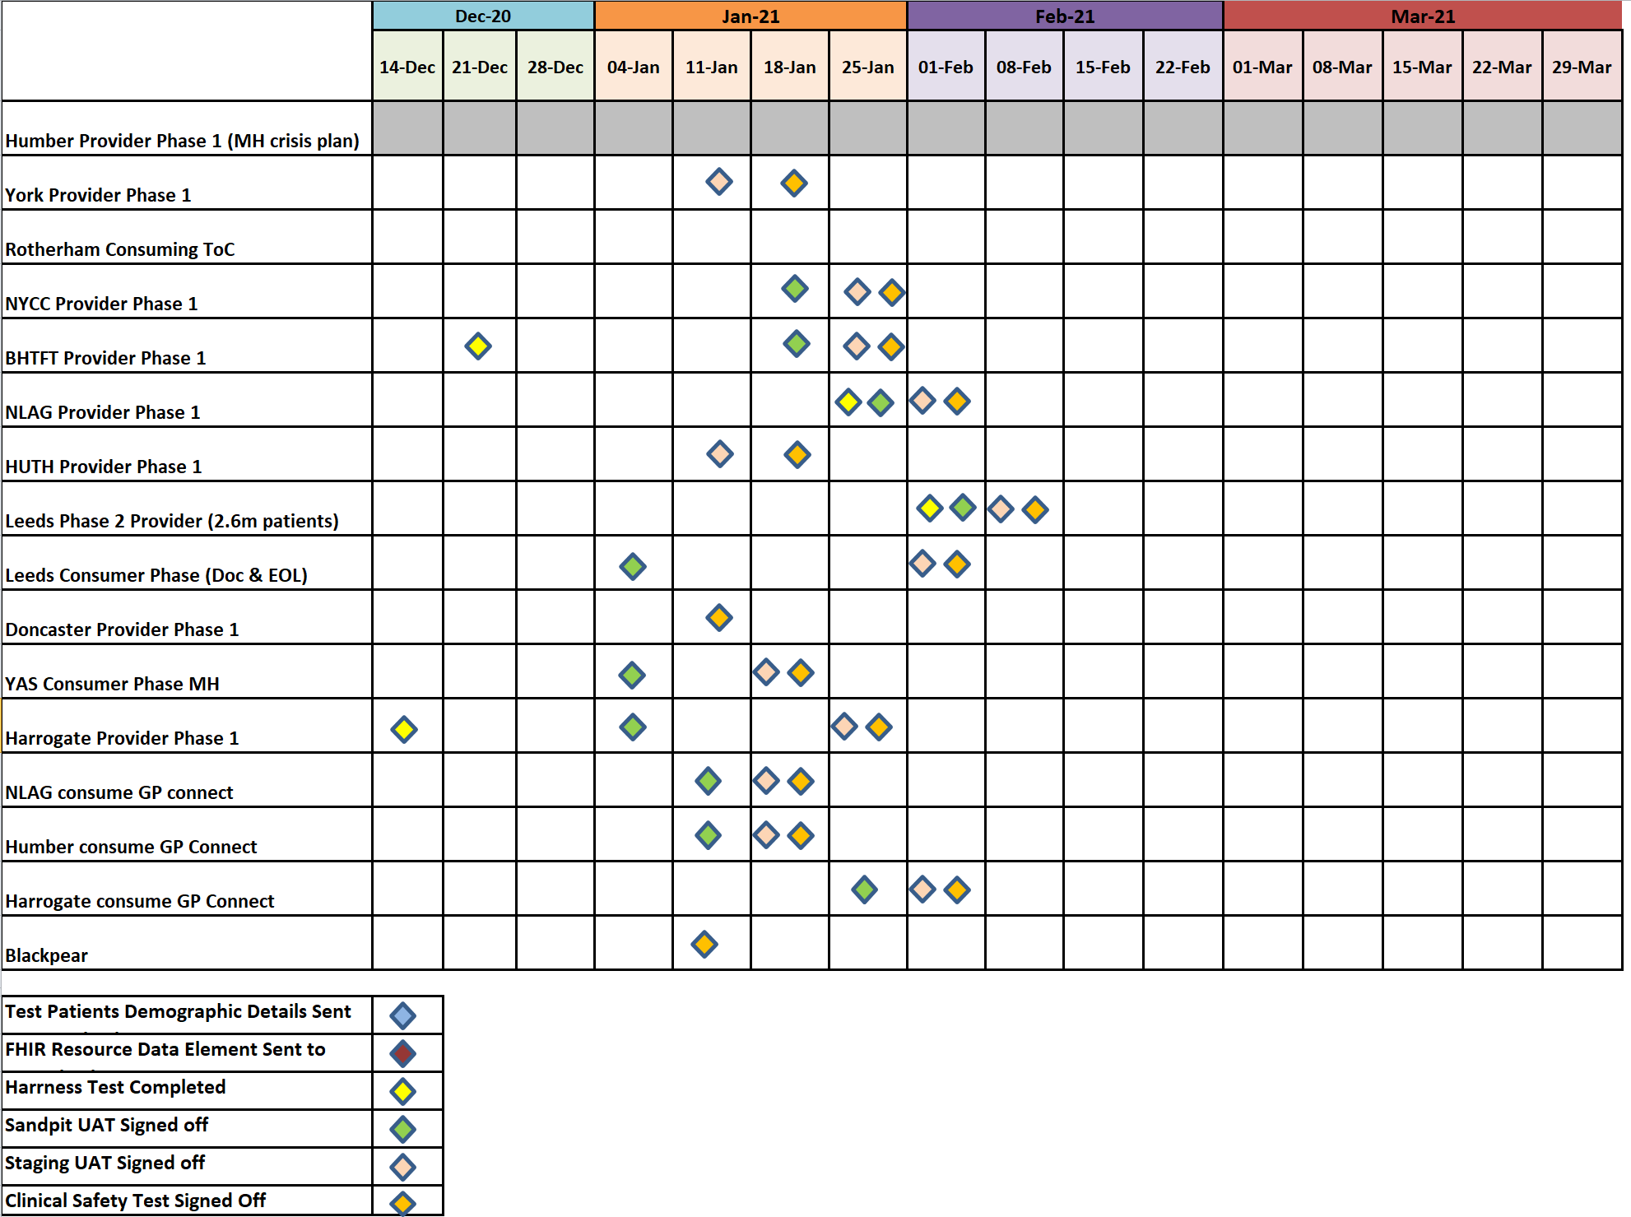
Workstream Report –Yorkshire and Humber Integrated Care Record Programme Report Date: 11 January 2021
Testing Dashboard
Overall Status:
Reported by: Kunle Sadare
Assured by: Julia Millman

Slide 9
Workstream Report –Yorkshire and Humber Integrated Care Record Programme Report Date: 11 January 2021
On-boarding Headlines
Overall Status:
Reported by: Nigel Hodgson
Assured by: Julia Millman
Provider Milestones | Use Case | RAG | Forecast Date | Progress | Planned activities | Blockers
YAS - Leeds | Transfer of Care |  |  | Go live completed 30th June | LTHT productionising daily error anomaly reports Switching to GCP will enable additional monitoring and alerting of live service to support service management process
Humber | Mental Health |  |  | 20 patients tested on the Prod Platform Further bug fixes confirmed as clinically safe 40k Patient cohort into PIX server complete CS testing complete; report sign off from CCIO | 3 – 6% of patients believed to have DXC issue - Awaiting DXC root cause analysis output in order to define next steps required. However Trust has confirmed they have clinically signed off the work as it is.
YAS | Consuming Mental Health |  | 26/01/21 | YAS testing of MH plan completed | YAS release can be scheduled (estimated 26 Jan) Future release will enable EoL data | Internal connectivity issues accessing Blackpear test environment
Rotherham | Transfer of Care |  | 20/01/21 | Rotherham full implementation scheduled | Move to GCP expected before 20/01/21 to minimise rework
York | Data provision |  | 25/01/21 | Code moved from dev to test/Staging environments | Clinical safety testing of York dataset Progression through staging into live Go Live approval | Issues around PIX have hindered progress
NLAG | Data provision |  | 18/12/20 | Connectivity via Internet First in progress – virtual server now available in DMZ | UAT and clinical safety testing TA documents returned | Change of developer has caused timing issues. Data provision cannot commence before GP-C work complete
NYCC | Data provision |  | 18/12/20 | Connectivity issues resolved | UAT and clinical safety testing Go Live scheduled | Old version of FHIR proxy needing updating
HUTH | Data provision |  | 09/12/20 | Complete technical assurance (incl. cyber) Complete PIX server work to enable patient identification YHCR Go Live approval granted | Switch on scheduled w/c 18/01/21

Slide 10
Workstream Report –Yorkshire and Humber Integrated Care Record Programme Report Date: 11 January 2021
On-boarding Headlines
Overall Status:
Reported by: Nigel Hodgson
Assured by: Julia Millman
Provider Milestones | Use Case | RAG | Forecast Date | Progress | Planned activities | Blockers
Doncaster | Data Provision |  | 23/11/20 | Switch on 25/11/20 | Final smoke testing scheduled 13/01/21
Harrogate | Data provision |  | 27/01/21 | Agree scope of phase 1 Encounters PIX work complete | Technical assurance and clinical safety documentation received UAT testing scheduled w/c 11 01 21
Bradford | Data provision |  | 27/01/21 | Scope changed to supply patient resource only | Data mapping development complete Connected to test suite using HSCN Technical assurance and clinical safety documentation received | Issues around connecting to sandpit
Leeds | Data Provision |  | 17/02/21 | Connected in sandpit | Complete UAT, clinical safety testing Progress to GO LIVE

Slide 11
Workstream Report –Yorkshire and Humber Integrated Care Record Programme Report Date: 07 December 2020
On-boarding Dashboard

Slide 12
Workstream Report –Yorkshire and Humber Integrated Care Record Programme Report Date: 11 January 2021
Other news
Funding– Shared Health Care Record funding to March 2021 has been allocated to YHCR, MOU being drafted for review by delivery board this week
Talk before you walk Clinical engagement and collaboration with NHS-D is ensuring this product will be fit for purpose when delivered next month
YHCR Service Design –YHCR Service design requirements are being agreed to support the tender for the long-term service solution.
YHCR Academy Proposal – Health Education England are submitting a proposal this week to delivery the academy .

Slide 13
Workstream Report –Yorkshire and Humber Integrated Care Record Programme Report Date: 11 January 2021
Risk Dashboard

Slide 14
Population Health Management
Highlight Report | 11/01/2021

Slide 15
Highlight Report – OpenEHR Capability Project Report Date: 11 January 2021
Project Summary
Current Phase:
Support and Deploy
Overall Status:
Project Overview: The Yorkshire and Humber Population Health Management (PHM) solution will enable higher quality health and care planning and leading edge data analytics.
The PHM solution continues to develop well during this “early life support” phase.
The Leeds Institute of Data Analytics (LIDA) are using the solution to further analyse the Comprehensive Patient Record (CPR) dataset using R-Studio and Python tools.
On the advice of NHSX, Humber Teaching Hospitals and NHS Digital we have submitted a section 251 request to the DHCS Clinical Advisory Group (CAG) on 16th October.
A further round of citizen engagement on the use of data for PHM and an enhanced Opt Out approach has commenced in support of the s251 approval
The Programme continues to work successfully with Connected Yorkshire and is providing new Stata analytics tooling.
A roadmap for engagement, enhancements and deployment is being developed (for 2021) and new service management arrangements are bedded in.
Engagement and planning sessions have been held with SYB and HCV to identify collaboration opportunities and potential use cases
Recent Trust connections to System of Systems and the planned Go Live of the national de-id service will make possible many more PHM projects.
Milestones | Baseline Date | Expected date | RAG Status | Est. % done | Comments
Additional bulk datasets loaded – cBradford | 31/05/2020 | 31/05/2020 |  | 100 | Complete
De/Re ID using national de-id testing approval – s251 | 31/05/2020 | 16/10/2020 |  | 70 | On track. Functionality proven with live environments and test data. Full use of NHS Digital service requires s251 approval of DHSC Direction.
PHM engagement webinars to showcase capability and encourage adoption | 22/10/2020 | 22/10/2020 |  | 100 | Complete
Interim Support arrangements finalised – YHCR PHM JIRA portal now live and fully functional | 31/07/2020 | 31/07/2020 |  | 100 | Complete
Transition to long term operational service | 01/10/2010 | 31/04/2021 |  | 80 | Interim arrangements in place.

